Slide 1
QIKcom-2 re-configurable Transponder module
Nestord Diaz-Ordaz, Bryan Hunt
Michael Segalla, & Cole Skinker
Advisor: Bob Bruninga
March 8, 2015

Slide 2
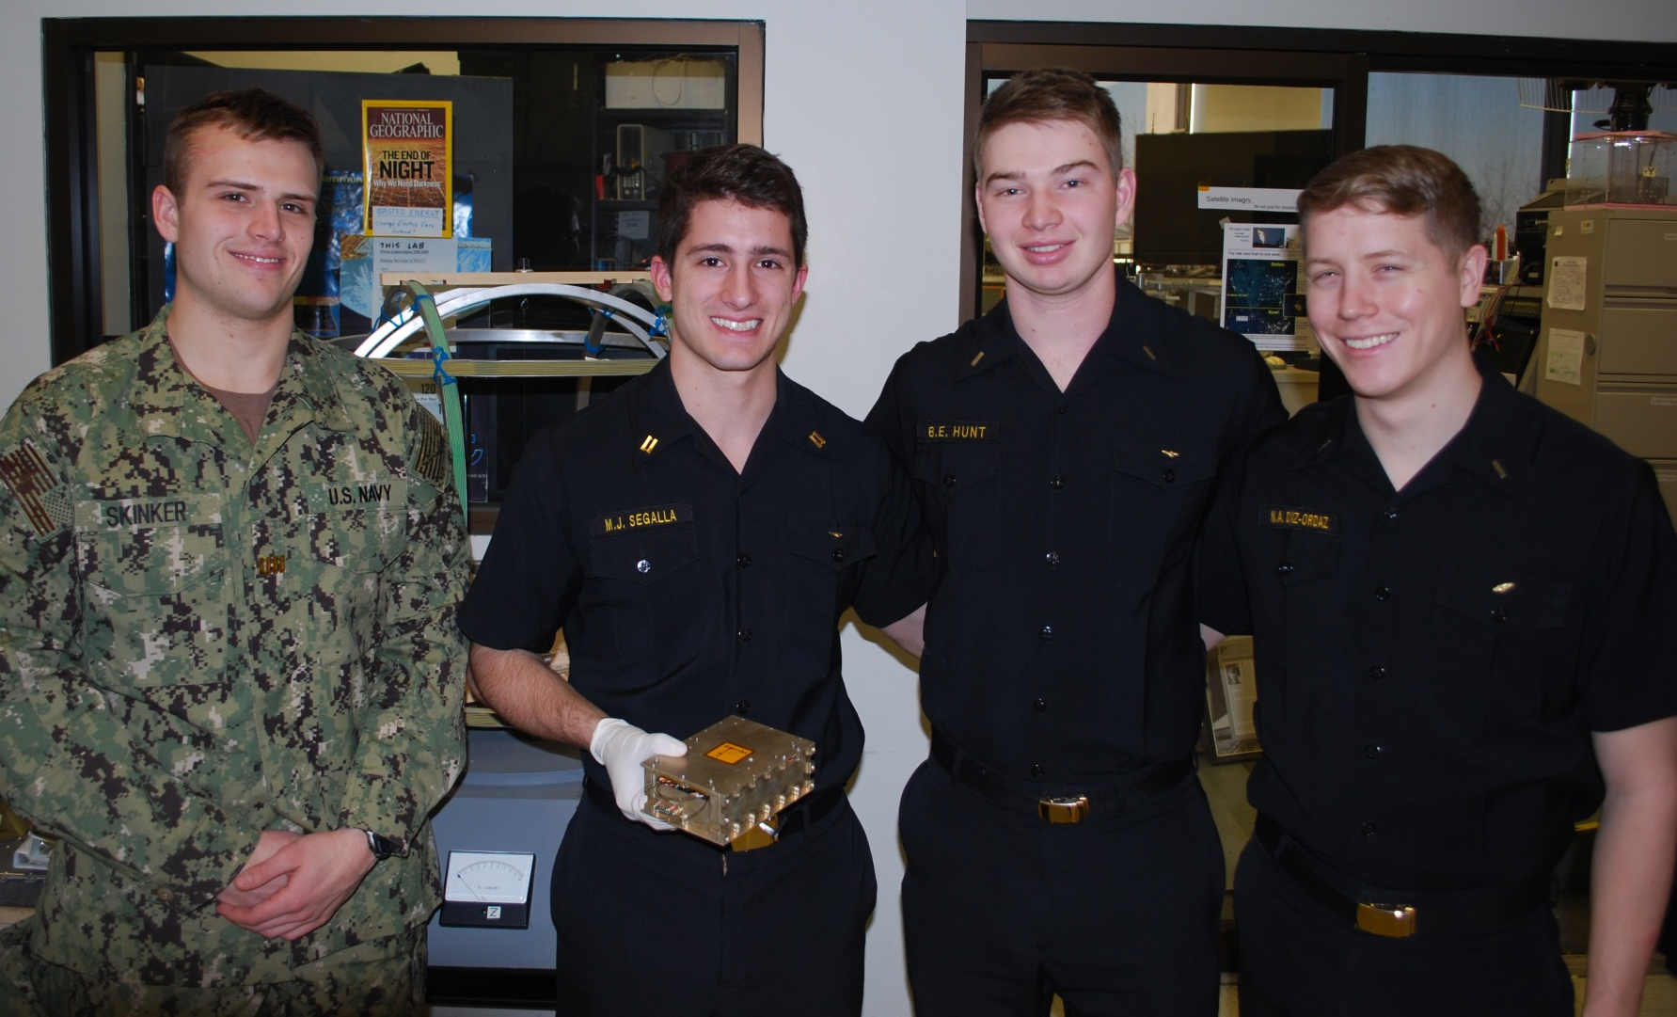
QIKcom Team

Slide 3
Problem Background
Automatic Packet Reporting System Protocol (APRS) is the primary communications protocol used by several USNA student satellite projects
With long development time, the response time for short fuse launch opportunities is limited
There is only one APRS satellite in operation currently

Slide 4
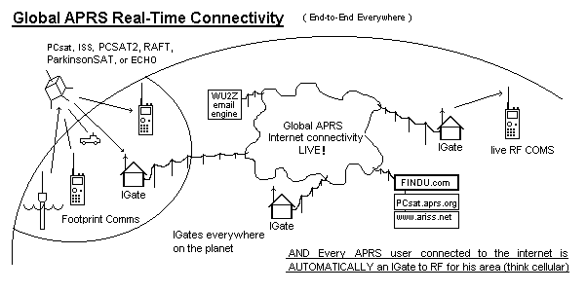
Automatic Packet Reporting System (APRS)
Notes:
Digital communications protocol where amateur users transmit data to passing satellites which relay that information to other users beyond the horizon
First employed in 1984 by cross-country endurance horse race for status updates and location tracking, now primarily used by amateur radio enthusiasts

Slide 5
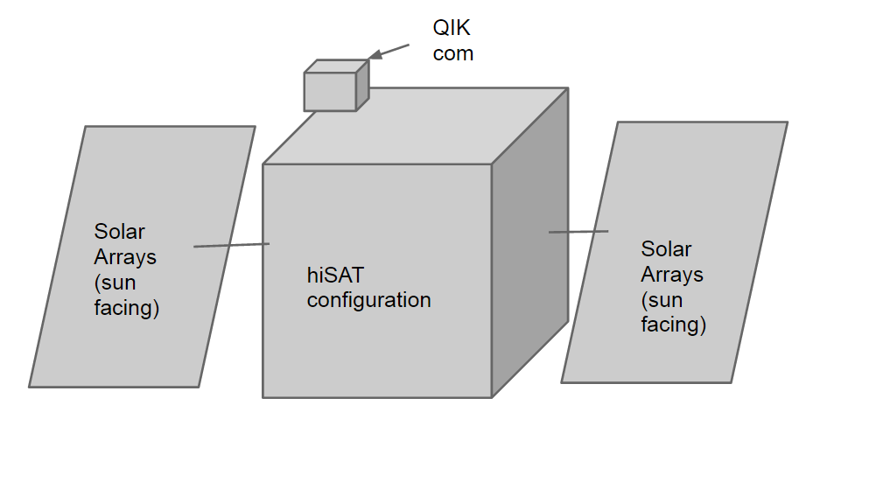
Host Satellite Opportunity: QIKcom-1
NovaWurks to host QIKcom1
Provides:
Power
Thermal Control
Attitude determination system
USNA provides capabilities:
Transponder to actively notify users
Power regulation
Antenna release mechanism

Slide 6
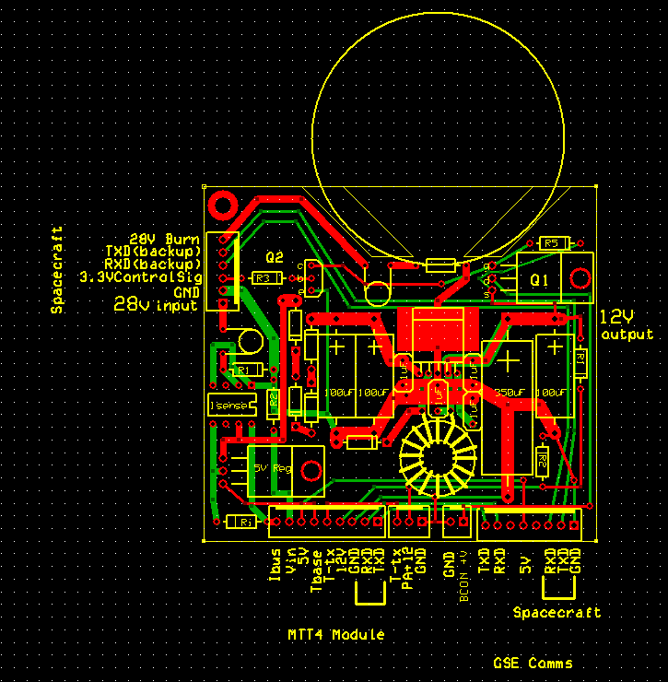
QIKcom-1 Components: Electrical Power System
Load | Operating Voltage |  | I _{pk} (mA) | Duty Cycle | I _{avg} (mA) | 28V I_{pk} (mA) |  | 28V I_{ave} (mA)
Beacon (Standby) | 12 |  | 15 | 98.3% | 14.75 | 7.14 |  | 7.02
Beacon (TX) | 12 |  | 600 | 1.70% | 10.2 | 260 |  | 4.86
MTT4 (TX-users) | 5 |  | 280 | 1.7% | 4.8 | 55.6 |  | 0.95
MTT4 (TX-Telemetry) | 5 |  | 280 | 4% | 11.2 | 55.6 |  | 2.2
MTT4 (RX) | 5 |  | 45 | 100% | 45 | 8.93 |  | 8.93
Power Amp (TX) | 12 |  | 600 | 10% | 60 | 260 |  | 28.6
Total |  |  |  |  |  | 647.3 |  | 52.6
28 V - Peak Power (W) |  | 18
28 V – Average Power (W) |  | 1.5
PCB Board Design
Power provided by host bus. P_{avg} of 1.5W consistent with 1U CubeSats, however all is dedicated to telemetry rather than other subsystems

Slide 7
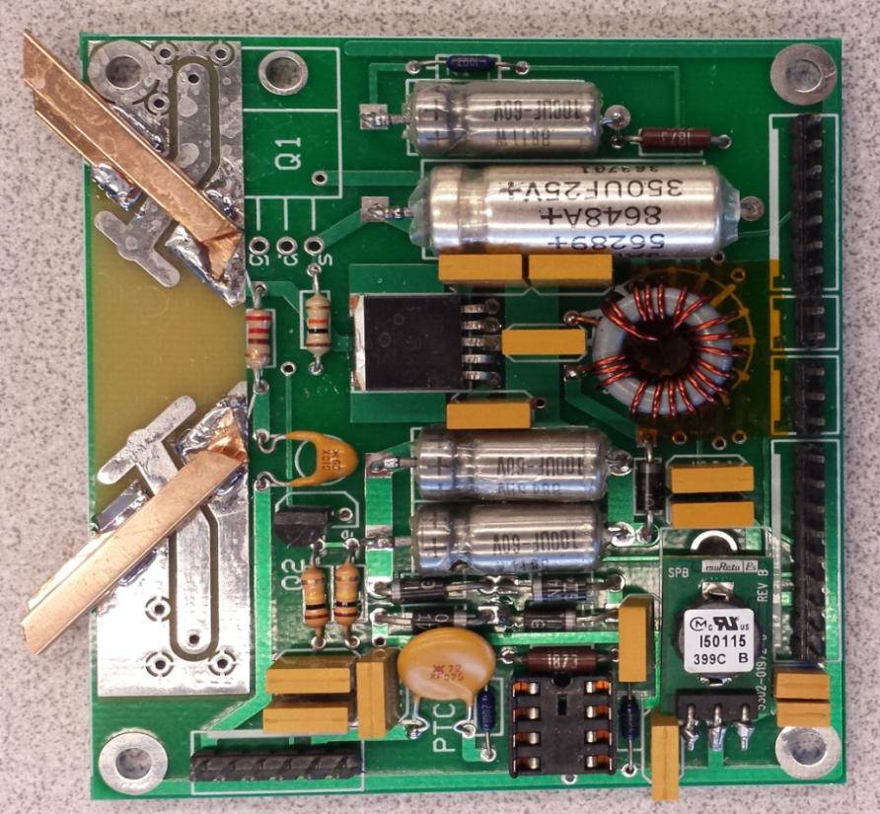
QIKcom Components: Antenna Deployment Mechanism
Attached to EPS Board
28 V burn signal sent by host spacecraft
¼ Watt 220 Ohm resistor
Approximately 3 Watts power
Burns through fishing line constraining the antennas in about 5 seconds
20 tests conducted with 100% reliability of release

Slide 8
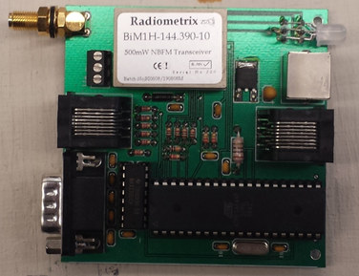
QIKcom Components: Transceiver and Transponder
TX only Beacon on QIKCOM-1 notifies terrestrial users when satellite is overhead
“145.825MHzQSY 4 OPS”
Command and Control Comms card and User Transponder:
Telemetry:
QIKCOM-1>APTT4,ARISS:T#001,28V, Ibus,12V,Base_Temp,Trans_Temp,00000011

Slide 9
QIKcom-1: Assembled Structure
Lid on Right, Baseplate on bottom
Irridite Aluminum, Emissivity: 0.11
Flathead screws with countersunk holes for smooth attachment to NovaWurks host

Slide 10
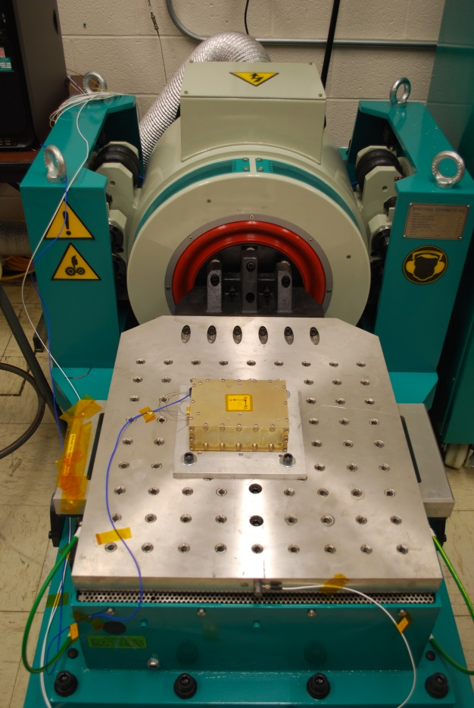
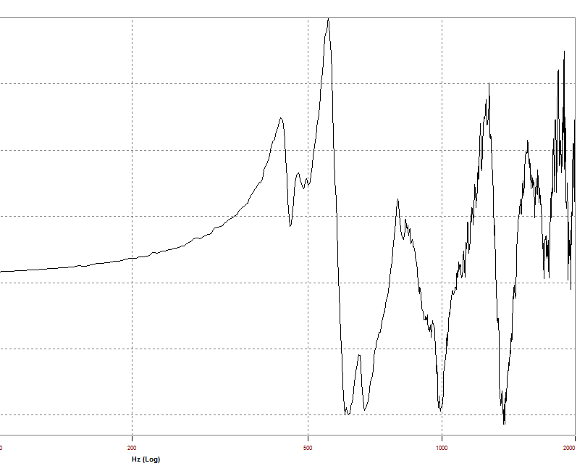
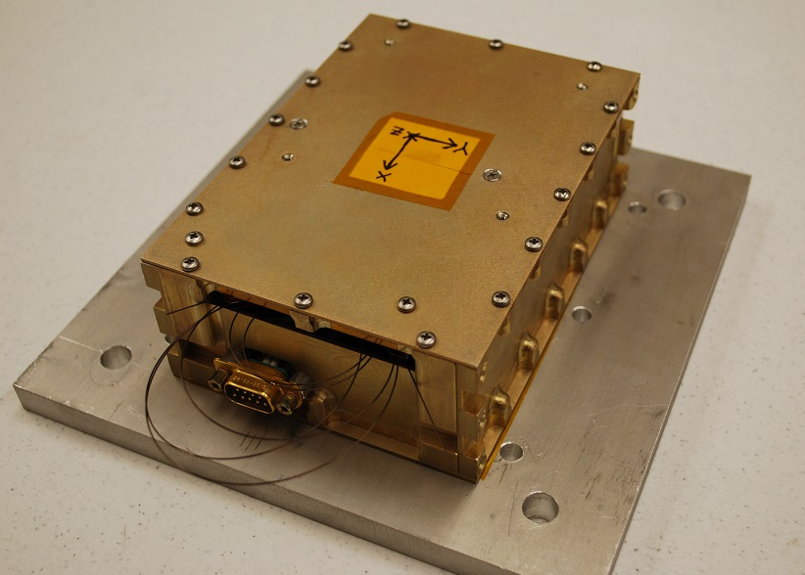
QIKcom-1: Vibe Test
Conducted 24 Feb 2015
Shaken in X and Y axes
Random vibe to Acceptance Levels of 10 G RMS
Both axes lowest resonance in both directions above 400 Hz
Satisfied the launch provider requirements
Pre and post-test sine tests conducted at 0.5G to identify any anomalies; none detected

Slide 11
QIKCOM-1 transition ideas to QIKCOM-2
APRS radios are expensive; Only 10% users have a radio that can use it
Yet all Amateur Radio Operators have a radio that can transmit TouchTones (DTMF)

Slide 12
QIKCOM-2: Solution for Everyone!
Adds DTMF (TouchTone uplink)
Text to speech + voice synthesizer
Arduino processor
Byonics MTT4B Packet Radio System
Target QIKCOM-2 for under $500

Slide 13
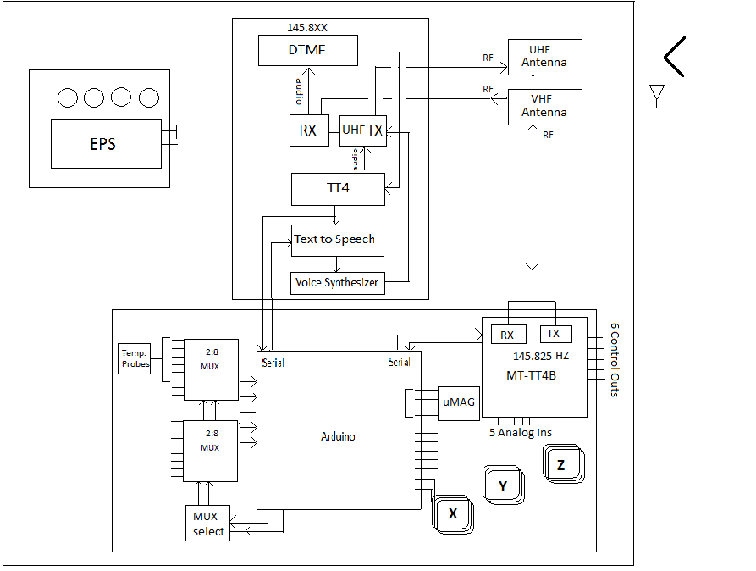
QIKcom2: Concept of Operations CONOPS

Slide 14
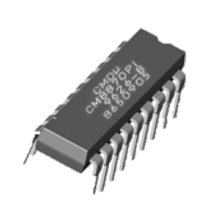
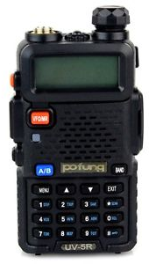
QIKCOM-2: DTMF up and Voice down CONOPS
DTMF
TX
VHF RX
Audio tones
Audio tones
16 Character Language
TT4
APRS packet
APRS packet
RX
UHF TX
Text-to-Speech
Audio Waves
Voice Synthesizer

Slide 15
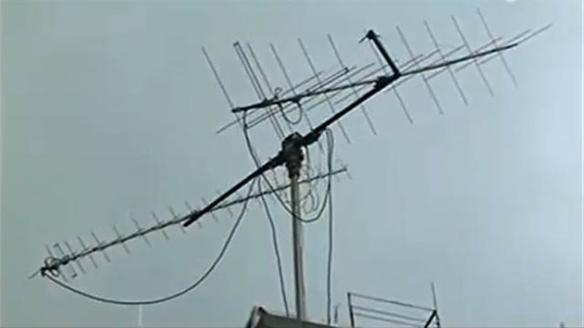
QIKCOM-2: Those with APRS radios - CONOPS
DTMF Decoding
TT4
MTT4-B
APRS packet
Ground Stations
APRS Radio
APRS packet
Global APRS Internet connectivity LIVE

Slide 16
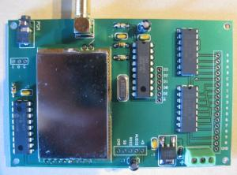
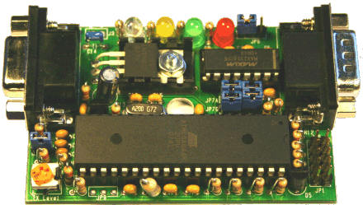
Dual-Tone Multifrequency Decoder & TT4
DTMF
Receives audio tones from amateur radios
Translates into 16 character language
$160
Parses 16-character language into APRS text packet
$30
TT4

Slide 17
Text-to-Voice capability for APRS users
Text-to-Speech chip receives APRS packet from Arduino; converts to audio-phone codes
Voice Synthesizer takes audio-phone codes and converts it to audio waves

Slide 18
Byonics.com MTT4-B Packet and Radio System
VHF Transceiver
Flexible frequency range at 145 MHz
Integrated power amp (detuned to 4W for QIKCOM-2)

Slide 19
Potential Cubesat Standalone Capability
These items could be added to t he QIKCOM-2 hardware to make it a standalone cubesat:
Magnetometers
Magnetotorquers
Solar Panels

Slide 20
Questions?

